Slide 1
Baseball Field Project
2020-2021

Slide 2
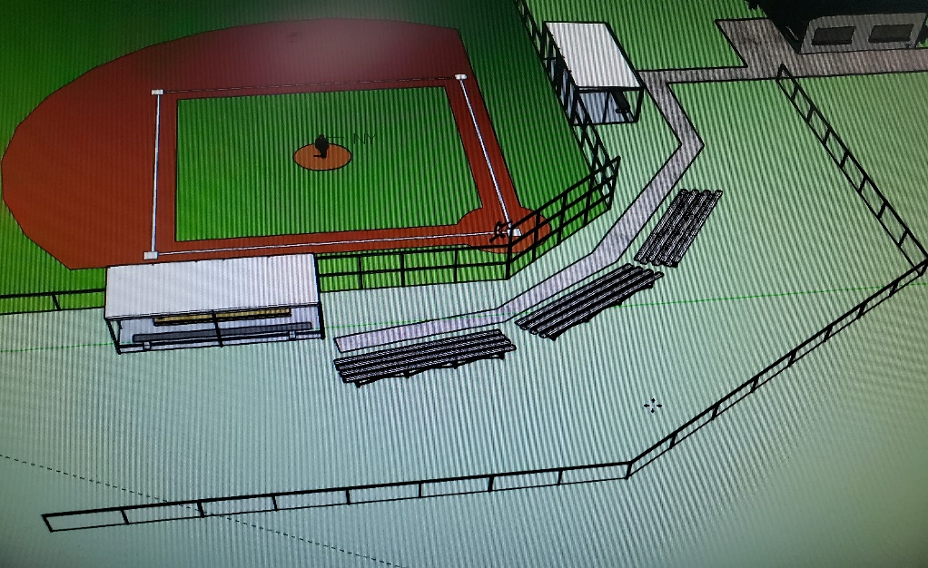
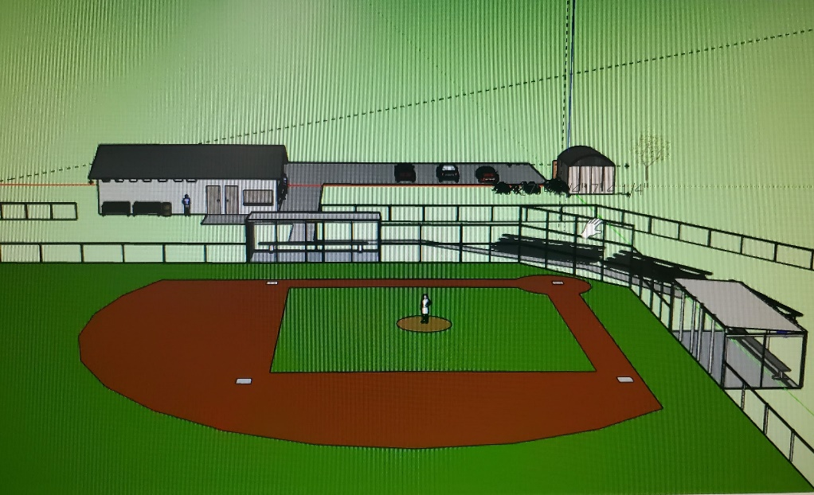
Checklist
Replace all doors
New roofs
Redo concrete
Benches
Hooks
Chain Link
Floors
Divider wall
Expansions
Replace Wood
Plant new grass
Dirt Work

Slide 3
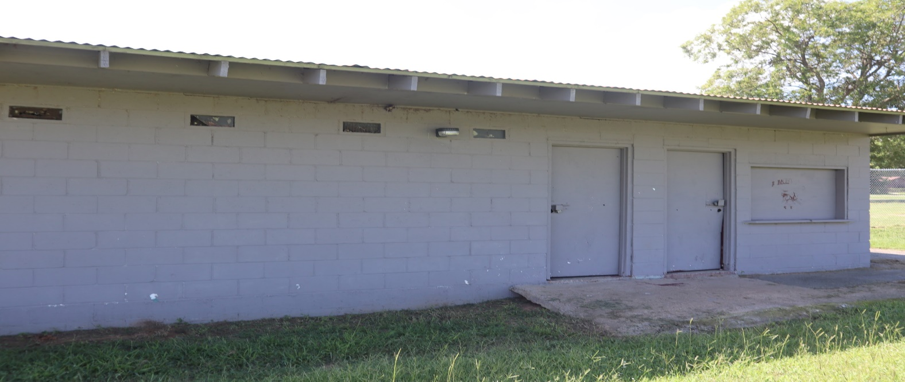
Concession Stand
Things Needed:
Replace all doors
Cabinets
New roof rusting
Cement
Landscaping

Slide 4
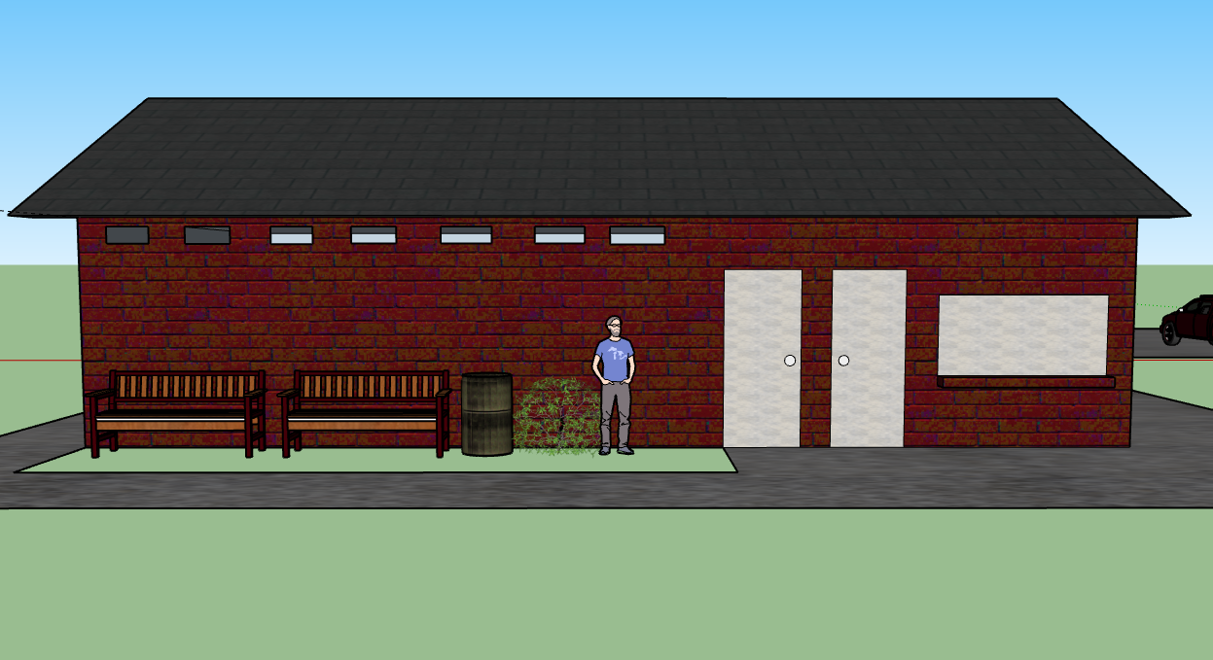
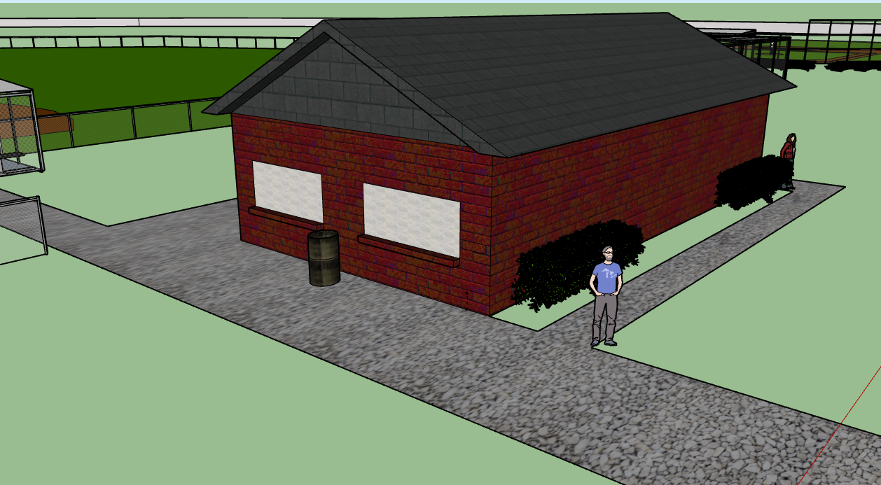
The New and Approved Concession Stand

Slide 5
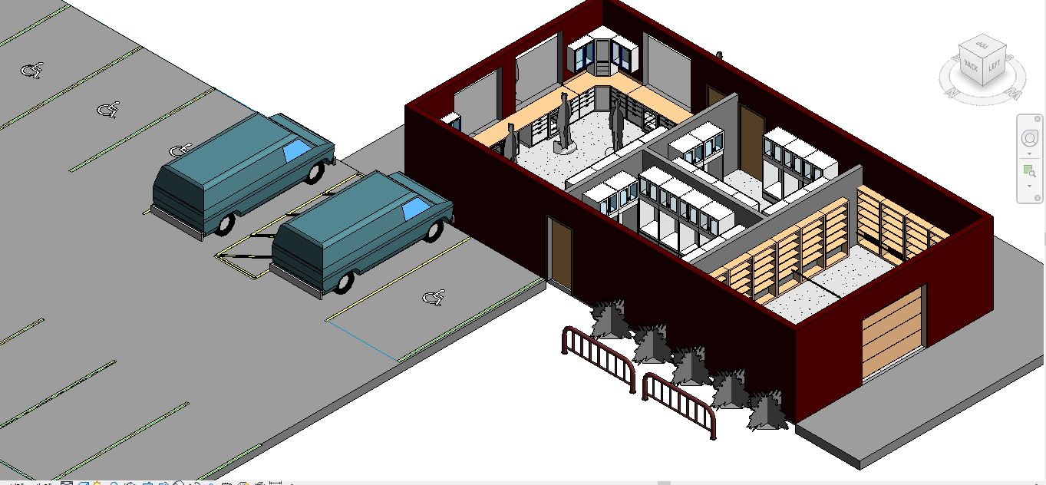
Interior For Concession Stand

Slide 6
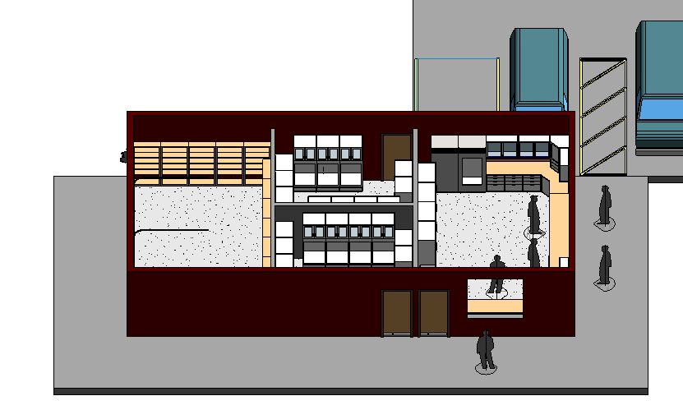
Second View

Slide 7
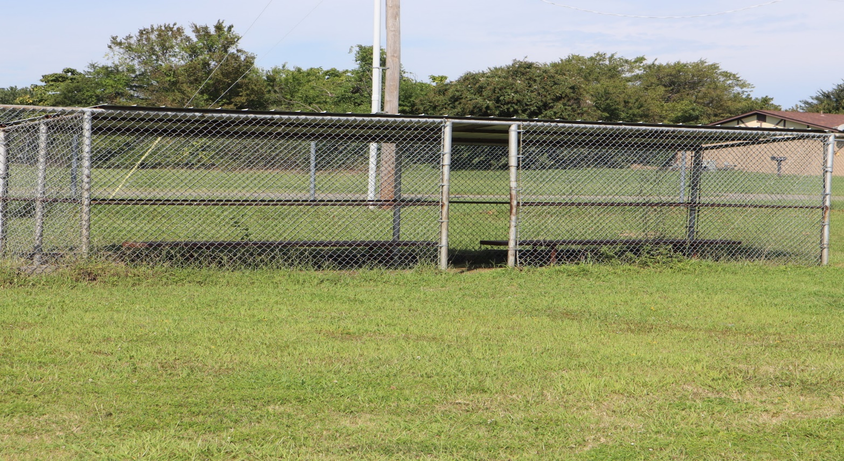
Dugouts Now
Shelf
Hooks
Benches
Chain link
Roof
Replace Wood

Slide 8
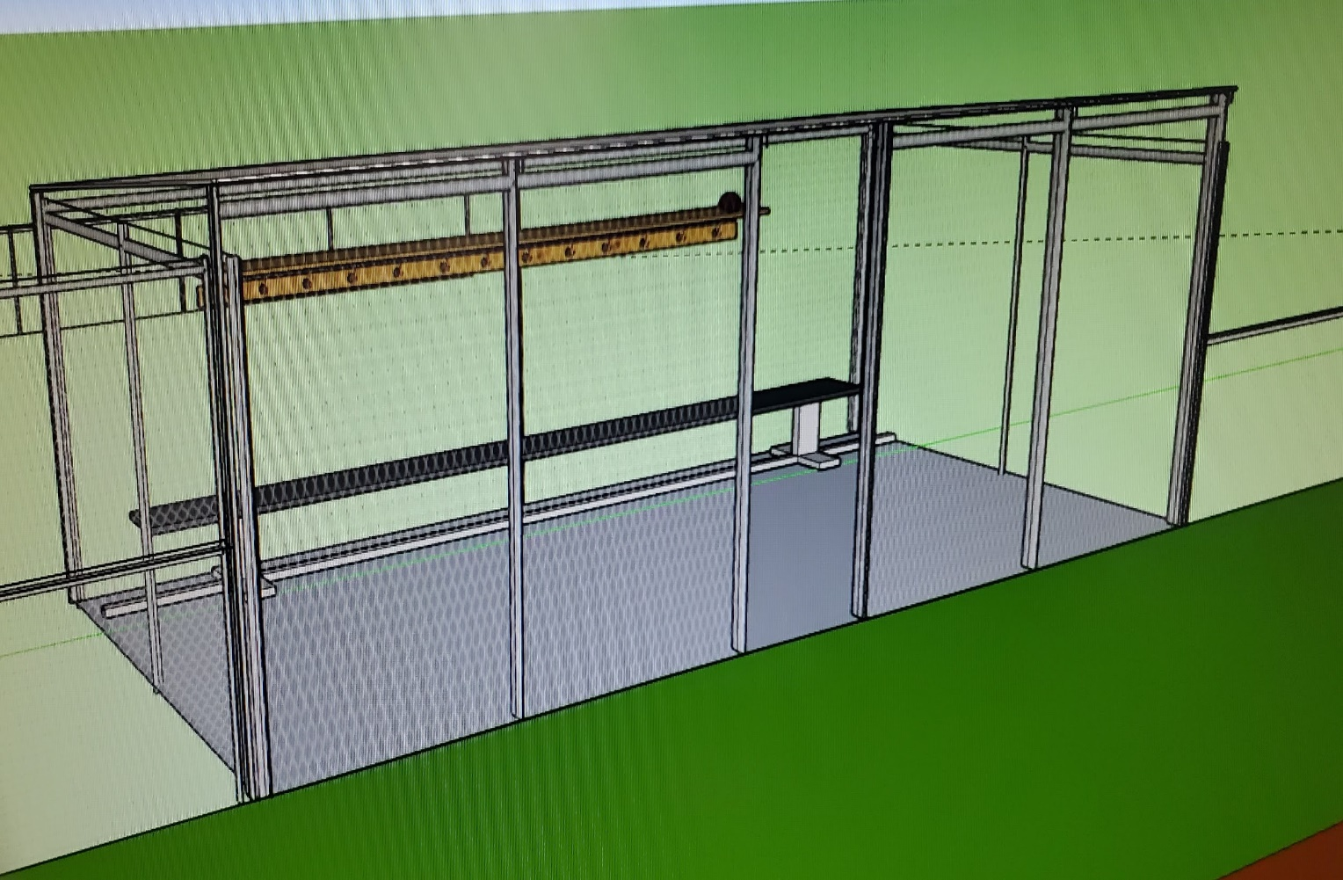
What we would like it to look like.

Slide 9
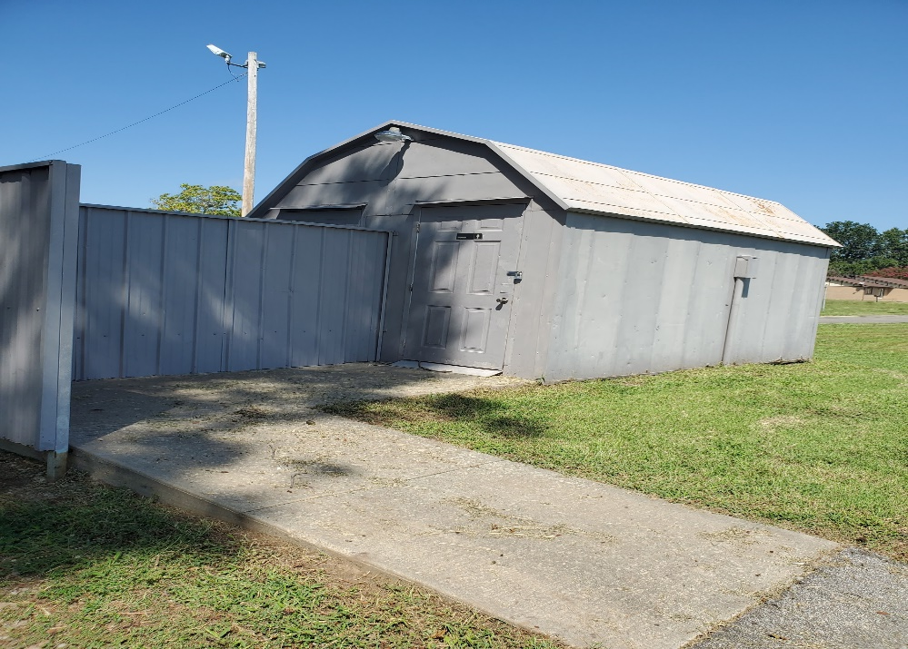
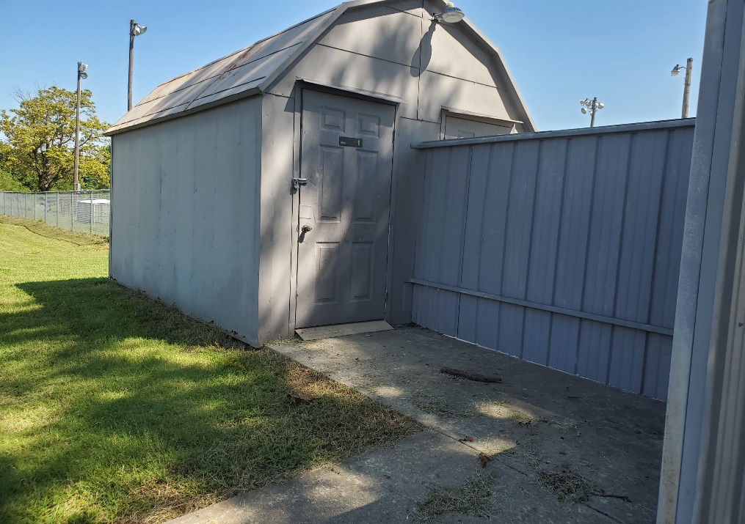
Restrooms
Roof
Stalls
Doors
Divider Wall
Repaint Restrooms
Sinks
Toilets
Floors
Power Wash Cement

Slide 10
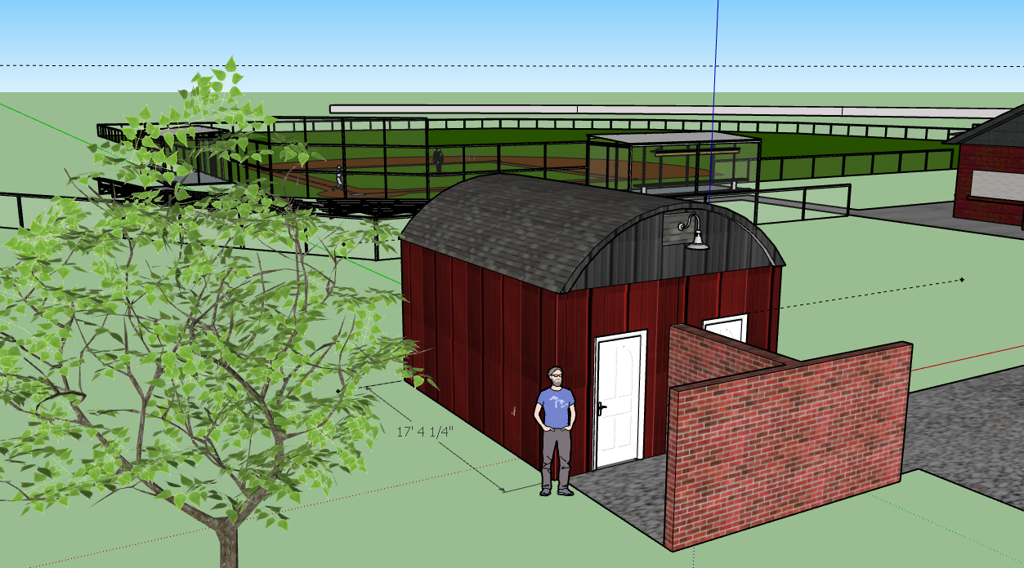
The
New Restrooms
(not brick)

Slide 11
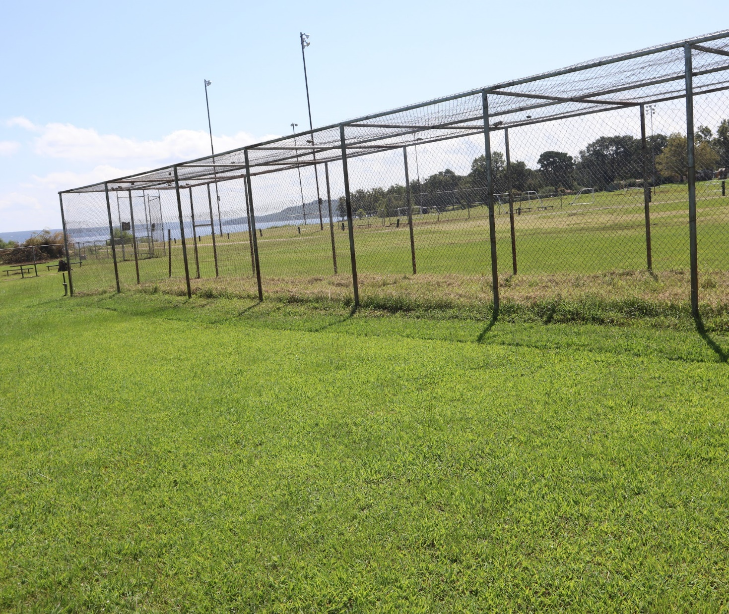
Batting Cages
Chain link
Expansion

Slide 12
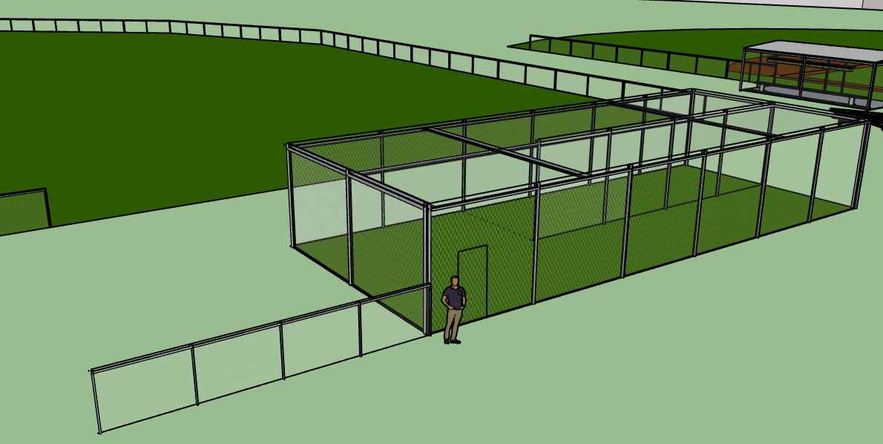
The New Batting Cages

Slide 13
Checklist
Replace all doors
New roofs
Redo concrete
Benches
Hooks
Chain Link
Floors
Paint divider wall
Expansions
Replace Wood
Plant new grass
Dirt Work

Slide 14
Prices
Concession stand:
Paint-$625
Shelves-$1,540
Refrigerator-$650
(L)cabinets-$1,500
(U)cabinets-$1,425
Counter top-$225
Doors(5)-$750
Shingles-$8,500
benches-$534
shrubs-$242
Dugouts:
benches-$920
Sheet metal(50)-$1,800 3x 14ft
Railroad ties-$5,000
Entire field:
Kentucky bluegrass(10LB)-$80
Dirt work-$1,434-$5,069
Batting cage:
Pipes: $400
Both batting cage and dugouts:
Chain link-$3,500
Retaining wall:
concrete-$160,000

